Slide 1
Lab 4a
Stochastic Actor Oriented Models (SAOMs)

Slide 2
Reminder about Lab 4
You have two options:
  4a (SAOM)
  4b (REM)
→ You only need to choose one for your report!
Both options have two parts:
  Part I: Hypothesis Construction
  Part II: Hypothesis Testing

Slide 3
SAOM → RSiena
The name SIENA stands for Simulation Investigation for Empirical Network Analysis
The method is implemented in the R package “RSiena”
SIENA is designed for analyzing longitudinal data of networks and behavior as dependent variables:
  The network will influence the dynamics of the behavior, and the behavior will influence the dynamics of the network, i.e., this is about the co-evolution of networks and behavior
Notes:
Stochastic actor-oriented models (SAOMs) - but to actually run them we use what’s called Siena which stands for Simulation Investigation for Empirical Network Analysis
So a couple of scholars put together this package a few years ago and it they tend to maintain it pretty well.
This package actually used to include ERGMs as well, but the ERGM aspect of it is not maintained so that's why we use a separate package in R for that.
SIENA is for the purpose of analyzing longitudinal data of networks and behaviors as dependent variables. That is, we’re trying to model the co-evolution of networks (e.g., people’s choices to create, dissolve, or maintain friendship ties) and behaviors (e.g., people’s choices to start, stop, or continue certain activities)
These changes are not individually observed, but they are simulated; what is observed is the state obtained at the next observation wave. This simulation model implements the statistical model for the network dynamics. The statistical procedures utilize a large number of repeated simulations of the network evolution from each wave to the next. They estimate and test the parameters producing a probabilistic network evolution that ‘could have’ brought these observations to follow one another.

Slide 4

Dataset
Teenage Friends and Lifestyle Study (West and Sweeting 1995, Michell and Amos 1997, Pearson and Michell 2000, Pearson and West 2003)
Cohort of teenagers in Scotland, 1995-1997
Network and behavioral data (friendship ties, substance use, athletics)
What factors predict the evolution of the network over time?
  Different substances?
  Homophily?
  Assimilation?
Notes:
Subset of 50 teenage girls who went to the school and were observed at three different time periods between 1995 and 1997.
You’re going to look at how their friendship networks and substance usage evolved over time
Noshir presented some results about alcohol consumption, but in this lab, we will do drug behavior

Slide 5
Part I - Hypothesis Construction
Notes:
In the previous lab assignment (ERGM), we gave you all of the hypothesis statements to test. In this lab, we will give you one hypothesis statement as an example, and then we will ask you to construct the remaining 6 hypothesis statements on your own based on the model terms given. You can look up what each term means in the SIENA Manual (which is provided in the Lab assignment)

Slide 6
Constructing Hypotheses
Two key things in your hypothesis statement
  Indicate a specific relation (i.e., higher or lower)
  For SAOM (longitudinal analysis), indicate “over time”
Example: We want to test outdegree
  Hypothesis 1: The probability of having a friendship relation between students will be lower over time than expected by random chance.
Notes:
The data is constructed such that there is a tie from A to B, if A mentions B as a friend
The given hypothesis here relates to each node’s outdegree (pg 130). We hypothesize that the probability of having a friendship relation between students will be lower over time than expected by random chance.
You need to construct 6 other hypotheses based on the model terms given. You can look up what each term means in the SIENA Manual (which is provided in the Lab assignment)

Slide 7
Part II - Hypothesis Testing
Notes:
Hypothesis testing is split into two parts: Informal and formal hypothesis testing

Slide 8
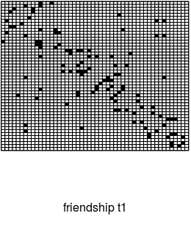
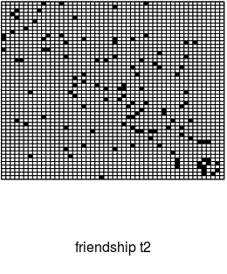
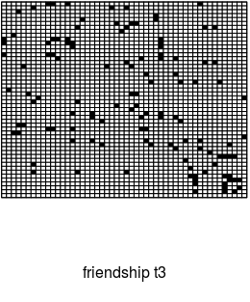
Interpreting Visualizations
V1 ------------------------> V50
To
V50 < ---------------- V1
From
3
4
Notes:
We start with informal
Here the ones and zeros are replaced with black and white cells
Friendship has directionality
Asymmetric friendship
Longitudinal data
First, look at one time period
Look at one row at a time and look across the columns (outdegree, student Y nominated X as a friend)
Look at one column across all rows (indegree, student X was nominated by Y as a friend)
Could comment on the sociality or popularity of each student this way
Second, compare all three time periods
Are there stable friendship clusters?
Are there pockets where no friendships existed and over time, they formed?
No right or wrong answers, just describe what you observe

Slide 9
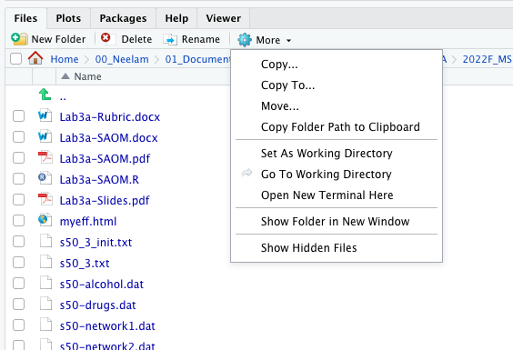
s50_3_init.out/.txt
1
2
3
4
Notes:
Now you’re going to generate some descriptive statistics of the dataset using RSiena
First go to your working directory, either within RStudio or in your folder on your computer. Open the text file titled as such.

Slide 10
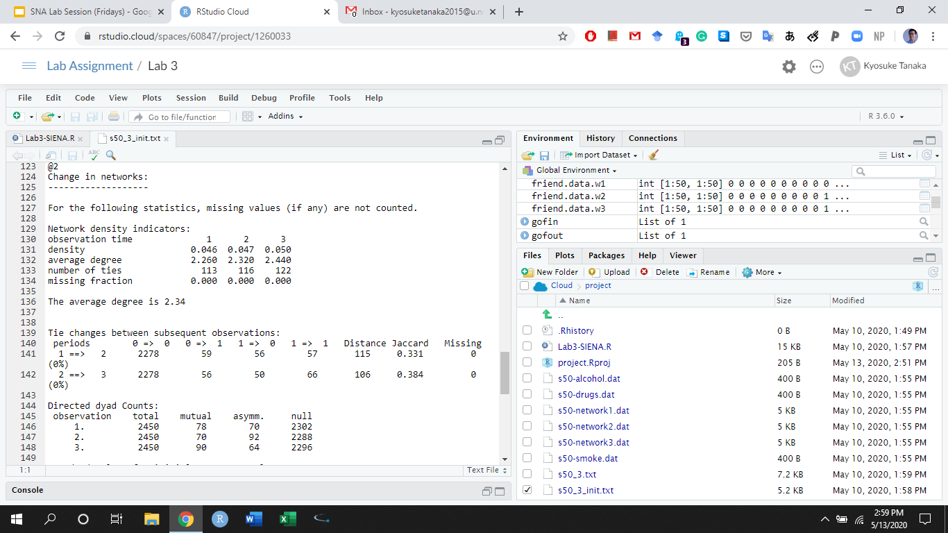
s50_3_init.out/.txt
Notes:
So based on the data, RSiena calculated some descriptive statistics. For example they calculated the density of the network at each time period, average degree of individuals in this network each time period, how many ties existed in the network at each time period, etc.

Slide 11
s50_3_init.out/.txt
How many friendship relations were created and dissolved between period 1 and 2?
How many students increased or decreased their use of drugs between period 1 and 2?
Notes:
What you need to do using this file is answer these two questions

Slide 12
s50_3_init.out/.txt
How many friendship relations were created and dissolved between period 1 and 2?
3
4
=>
3
4
3
4
=>
3
4
Notes:
To answer these questions, you need to learn how to read tables like this, which you’ll find all the way the bottom of your text file.
The rows represent the time periods in question and the columns represent tie changes between nodes in the network
0 → 0 means whether tie existed between the pair of nodes in the first period, whether tie existed in the second period
If you add up 2278+59+56+57 = this is the total number of ties that CAN possibly exist in the network
Remember this is a directed network so the total number of ties that can possibly exist = n*(n-1), so you should get 50*49 = 2450 here
Also just as a side note, the distance and jaccard columns here are just means of comparing how similar the two adjacency matrices are

Slide 13
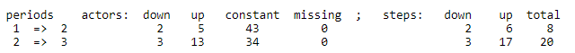
s50_3_init.out/.txt
How many students increased or decreased their use of drugs between period 1 and 2?
3
4
=>
3
4
3
4
=>
3
4
Drug Use: none, tried once, occasional, regular
Notes:
Now forget about ties, we’re just focusing on nodal attributes here
In particular, we are looking at our DV here which is drug behavior
There are four types of drug behavior: none, tried once, occasional, and regular
Actors:
This number is counting how many people increased or decreased numbers between time periods
Constant means they gave the same answer at periods one and two
Row adds up to 50
Steps:
Down: there were two people who changed their response down one step
Up: there were 4 people who changed their response up one step and 1 person who changed their response up two steps

Slide 14
Testing Hypotheses
Yes
No
Similar to ERGM Lab
p-value < 0.05
Run a statistical test (i.e., SIENA)
See p-value of the proper variable
Fail to reject the null hypothesis (don’t interpret the estimate)
Accept the proposed hypothesis & interpret the estimate
Sign of the estimate aligns with the proposed hypothesis?
Reject the null hypothesis
Reject the proposed hypothesis & interpret the estimate
Notes:
Now we move to formal hypothesis testing - it is almost exactly the hypothesis testing that you’re doing for the ERGM lab. I’ve shared this flow chart with you before. This time, however, you’ll be interpreting RSiena output.
First look at the p-value associated with the variables you’re testing (so outdegree would be the variable for Hypothesis 1)
If the p-value is greater than 0.5, you reject your hypothesis and don’t interpret the estimate
If the p-value is less than 0.5, you check the sign on the estimate and proceed to interpret whether your hypothesis was supported or rejected and to what extent

Slide 15
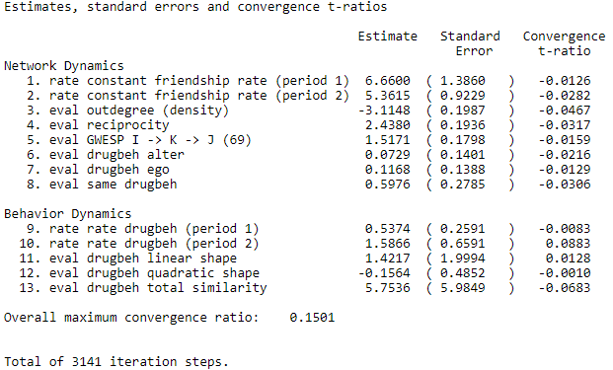
If you run ans1
All t-ratios for convergence should ideally be less than 0.1 in absolute value
The overall max convergence ratio should ideally be less than 0.25
Notes:
Now similar to ERGM, there’s no point in interpreting your results unless you have good model convergence.
Remember RSiena relies on a large number of repeated simulations of the network evolution from each wave to the next to produce the given parameters.
The convergence check considers the deviations between simulated values of the network statistics and their observed values. Ideally, these deviations should be 0. Because of the stochastic nature of the algorithm, when the process has properly converged the deviations are small but not exactly equal to 0. The Program calculates the averages and standard deviation of the deviations and combines these in a t-ratio (in this case, average divided by standard deviation). The overall maximum convergence ratio is the maximum value of the ratio average deviation / standard deviation for any linear combination of the target values.
For this assignment, you shouldn’t find any issues with model convergence but if you choose to use SAOMs for your final project and you encounter issues with model convergence, just let me know and we can talk through some tricks to get better convergence.

Slide 16
Once you confirm the convergence
================================================
Model 1
------------------------------------------------------------------------------------
constant friendship rate (period 1) 6.66 *** (1.39)
constant friendship rate (period 2) 5.36 *** (0.92)
outdegree (density) -3.11 *** (0.20)
reciprocity 2.44 *** (0.19)
GWESP I -> K -> J (69) 1.52 *** (0.18)
drugbeh alter 0.07 (0.14)
drugbeh ego 0.12 (0.14)
same drugbeh 0.60 * (0.28)
rate drugbeh (period 1) 0.54 * (0.26)
rate drugbeh (period 2) 1.59 * (0.66)
drugbeh linear shape 1.42 (2.00)
drugbeh quadratic shape -0.16 (0.49)
drugbeh total similarity 5.75 (5.98)
-----------------------------------------------------------------------------------
Iterations 3141
================================================
*** p < 0.001, ** p < 0.01, * p < 0.05
The estimate (log-probability ratio)
The standard error
Notes:
Once you confirm model convergence, you can generate a table like this to interpret your results
Here the p-values are represented by asterisks (the key is given here)
Similar to ERGM, the estimates come back as log-probability ratios (more on than in a bit)
Comparable to the log-odds ratios known from logistic regression; since the choice here is multinomial rather than binary, the correct term is probability ratios rather than odds ratios
The numbers in parentheses indicate standard errors
So if you, for some reason didn’t want to use the p-values given in this way, you can determine significance by doing the estimate / standard error and if the value is greater than 1.96, you know the p-value will be less than 0.05

Slide 17
Check the corresponding variable to hypothesis
================================================
Model 1
------------------------------------------------------------------------------------
constant friendship rate (period 1) 6.66 *** (1.39)
constant friendship rate (period 2) 5.36 *** (0.92)
outdegree (density) -3.11 *** (0.20)
reciprocity 2.44 *** (0.19)
GWESP I -> K -> J (69) 1.52 *** (0.18)
drugbeh alter 0.07 (0.14)
drugbeh ego 0.12 (0.14)
same drugbeh 0.60 * (0.28)
rate drugbeh (period 1) 0.54 * (0.26)
rate drugbeh (period 2) 1.59 * (0.66)
drugbeh linear shape 1.42 (2.00)
drugbeh quadratic shape -0.16 (0.49)
drugbeh total similarity 5.75 (5.98)
-----------------------------------------------------------------------------------
Iterations 3141
================================================
*** p < 0.001, ** p < 0.01, * p < 0.05
H1: The probability of having a friendship relation between students will be lower over time than expected by random chance.
Check the p-value
Check the sign (whether your hypothesis and sign match)
Interpret the estimate converting into either a probability ratio or probability
Notes:
Let’s make this more concrete
Testing the given Hypothesis (#1)
We see here that the p-value is less than 0.001 so it’s statistically significant
The sign is negative
Which is consistent with our hypothesis, so we support it
Now we interpret the estimate

Slide 18
Interpret the Estimate of Density
Run exp(-3.11)
→ 0.04460096
Exponential: probability ratio (if a probability ratio is 1, probabilities are even)
  The probability of individuals reporting a friendship tie is 0.04 times lower than random chance over time.
Notes:
How do we interpret the estimate?
The estimated parameters for each effect should be interpreted as log-probability ratios (this is comparable to the log-odds ratios from logistic regression; but since the choice here is multinomial rather than binary, the correct term is log-probability ratios rather than log-odds ratios).
You can interpret the estimate as either a probability ratio or a probability. To interpret as a probability ratio, you just take the exponential of the estimate and you can conclude the probability of individuals reporting a friendship tie is

Slide 19
Interpret the Estimate of Density
Run exp(-3.11)/(1+exp(-3.11))
→ 0.04269664
Inverse logit (plogis): probability (random chance is 50%)
  The probability of having a friendship tie between students in the network is 4% over three years.
Notes:
Alternatively to interpret as a probability, you just take the ratio of exponentials of the estimate here and conclude the probability of individuals reporting a friendship tie is just 4% over three years.
Which is much lower than random chance, because random chance is 50%

Slide 20
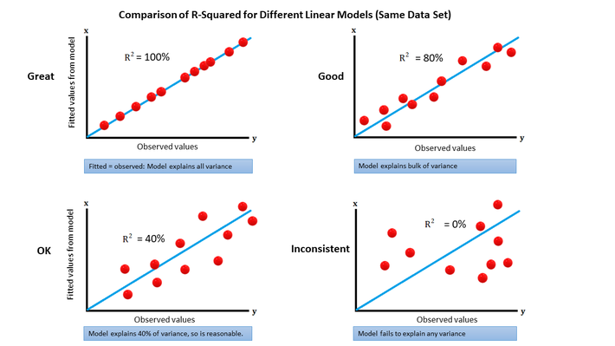
Goodness-of-fit Test
Does my model (i.e., the results of SAOM) fit well with my network data?
Think of a goodness-of-fit test as R-squared in regression
Notes:
Finally, you’re going to run a goodness of fit test. Does the model generated by RSiena fit well with our original data?

Slide 21
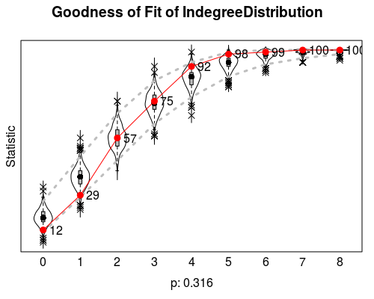
Goodness-of-fit Test of Indegree
Red dots and line indicate the original network values
Grey dot lines indicate 95% confidence intervals
If p > .05, it indicates that the model fits well with the original network in terms of the in-degree distribution
Notes:
This slide shows indegree but the concept is the same for outdegree
So like before…
Based on the RSiena model, we generated a bunch of networks
We created this box and whisker plot shown in grey based on those simulated networks
How to read this plot:
12% had an indegree of zero in this dataset
If you look at indegree of 1, 17 more students had an indegree of 1
So the plot is additive
We want the red to align well with the grey
We’re using the Mahalanobis Distance to calculate the similarity between the true network and the distribution of simulated networks and calculating the p-value

Slide 22
Q & A

